Slide 1

Health Metrics
Forecasting Service
Page
01

Slide 2

Problem
Statement
Healthcare providers need early predictions of health trends.
Manual tracking of metrics → time-consuming & reactive.
Lack of accessible API-driven forecasting tools for health data.
Aim → Build a simple, API-first forecasting service for health data.
Page
02

Slide 3


Objectives
Develop a FastAPI-based service for
forecasting.
.
Provide REST endpoints for:
Health check (/health)
Forecasting (/forecast)
Enable integration with frontends or apps via API
Make it accessible globally using Ngrok.
Page
03

Slide 4
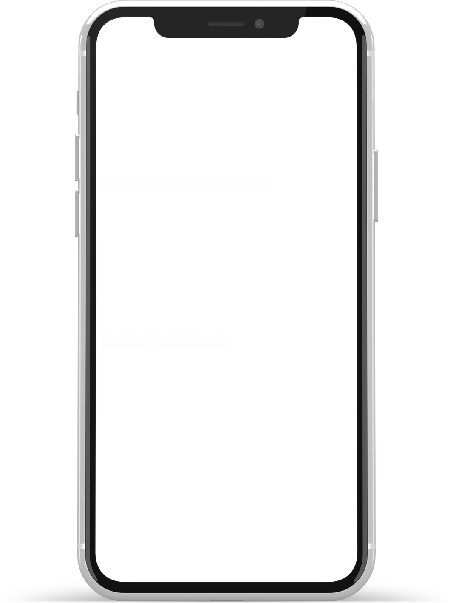
FastAPI → to build RESTful API endpoints (/health, /forecast)
Requests → to test API endpoints from client side
Ngrok → to expose local FastAPI server to the internet
Uvicorn → ASGI server to run the FastAPI app
(Optional, if you actually imported/used them in notebook)
Pydantic → for request/response validation
Libraries &
Tools Used
Page
04

Slide 5
Target
Audience
🏥 Healthcare Analysts – quick forecast reports.
👩‍⚕️ Doctors & Hospitals – anticipate patient surges.
📊 Data Scientists – integrate forecasting API into pipelines.
🧑‍💻 Developers & Students – learning API-based health projects
Page
05

Slide 6


API
Endpoints
GET /health:
Returns system status ("Service is up and running")
POST /forecast:
Input: {"horizon": 5} (integer forecast horizon)
Output: Simulated forecast (JSON list of future values)
Page
06

Slide 7
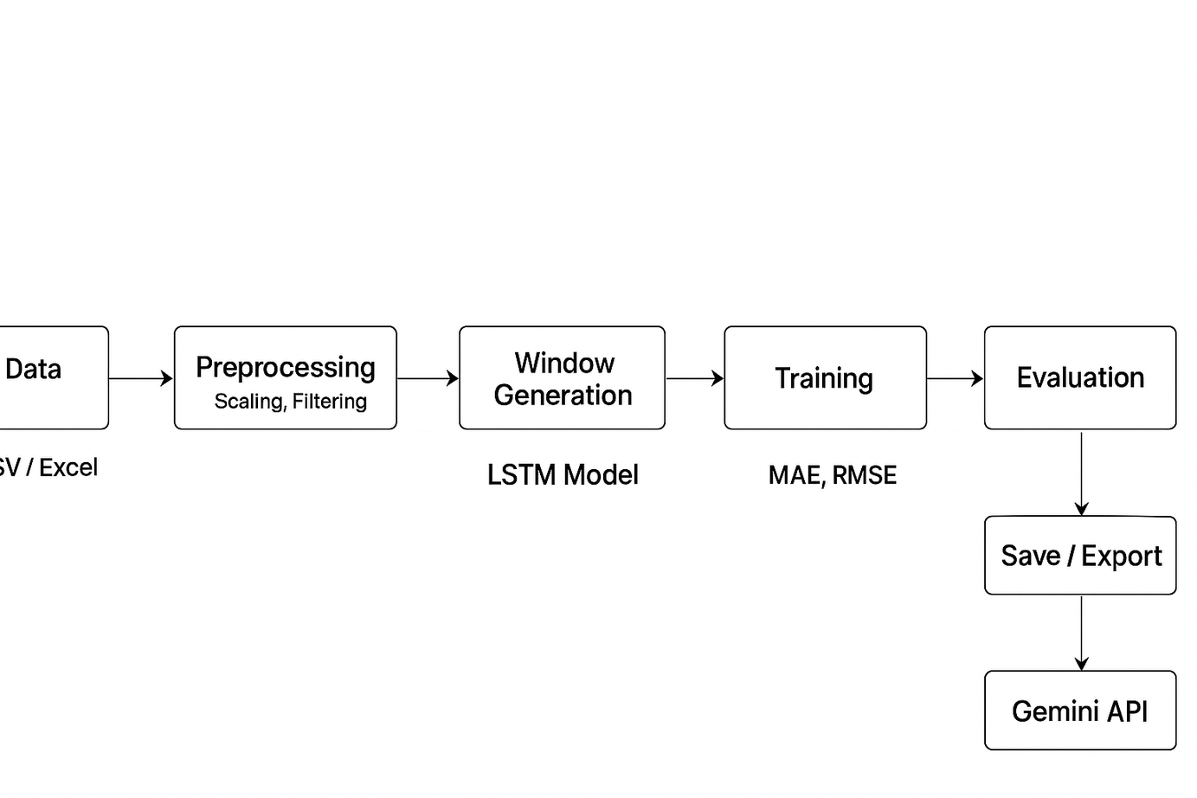
Architecture &
Dataflow
Page
07

Slide 8
Benefits &
Impact
⚡ Lightweight & Fast (built on FastAPI).
🌍 Accessible anywhere with Ngrok.
🔗 Easy integration into mobile/web apps.
📈 Helps proactive healthcare decisions (resource planning, patient care).
🔒 Secure API structure (only exposed endpoints).
Page
08

Slide 9
Future
Evolution
📌 Advanced Models – integrate ML/DL forecasting (Prophet, LSTMs).
📌 Database Integration – store patient/metric history.
📌 Visualization Dashboard – real-time graphs for doctors.
📌 Scalability – deploy on cloud (AWS/GCP).
📌 Security Enhancements – authentication & role-based access.
Page
09

Slide 10
Thank
You.
Page
10

